Slide 1
Chemical composition and layering system of the earth
According to Suess:-
E.Suess has thrown light on the chemical composition of the earth’s interior. The crust is covered by a thin layer of sedimentary rocks of very low density. This layer is composed of crystalline rocks, mostly silicate matter.
The dominant minerals are feldspar and mica. The upper part of this layer is composed of light silicate matter while heavy silicate matter dominates in the lower part
Suess has identified three zones of different matter below the outer thin sedimentary cover.

Slide 2
Three zone
SIAL:- Located just below the outer sedimentary cover is composed of granites. This layer is dominated by silica and aluminium (SIAL=SI+AL).
The average density of this layer is 2.9g cm-3 whereas its thickness ranges between 50 to 300 km.
This layer is dominated by acid materials and silicates of potassium, sodium and aluminium are abundantly found. Continents have been formed by sialic layer.

Slide 3
SIMA
SIMA:- Is located just below the sialic layer. This layer is composed of basalt and is the source of magma and lava during volcanic eruptions.
Silica (SIMA= SI+MG) and magnesium are the dominant constituents. Average density ranges between 2.9. to 4.7. where as thickness varies from 1000 km to 2000 km.
There is abundance of basic matter. The silicates of magnesium, calcium and iron are most abundantly found.

Slide 4
NIFE
NIFE:- Is located just below the ‘sima’ layer.
This layer is composed of nickel (NI) and ferrium (Fe).
It is, thus, apparent that this layer is made of heavy metals which are responsible for very high density (11) of this layer.
The diameter of this zone is 6880km. The presence of iron indicates the magnetic property of the earth’s interior. This property also indicates the rigidity of the earth.

Slide 5
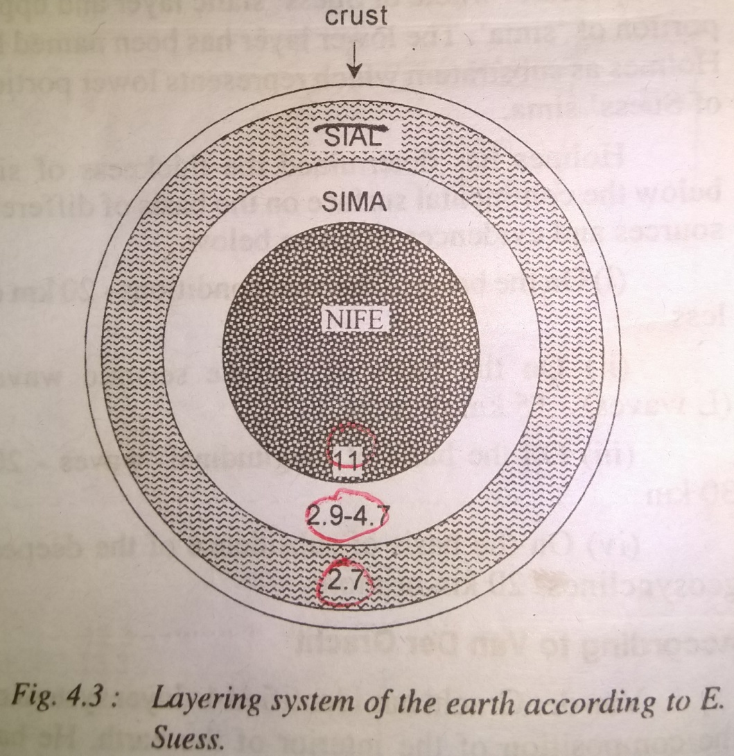
Interior layers of earth according to E.Suess

